Slide 1
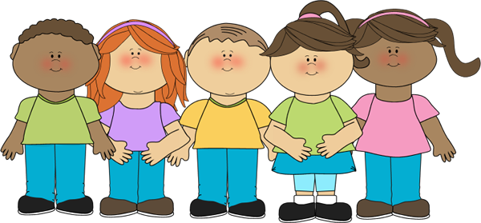
The More We Are Together

Slide 2
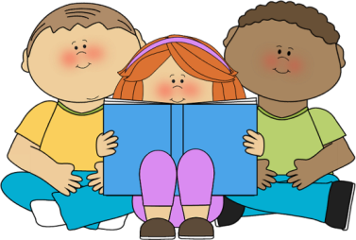
The more we together, together, together,
read
The more we together, the happier we’ll be.
read
Cause your are my .
books
books
And my are your .
books
books
The more we together, the happier we’ll be!
read

Slide 3
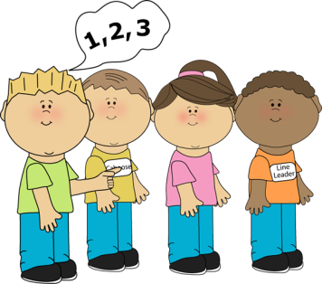
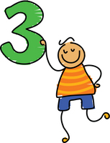
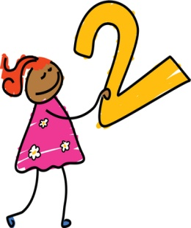
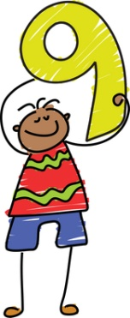
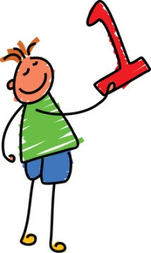
The more we together, together, together,
count
The more we together, the happier we’ll be.
count
Cause your are my .
numbers
numbers
And my are your .
numbers
numbers
The more we together, the happier we’ll be!
count

Slide 4
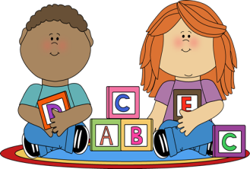
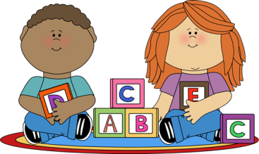
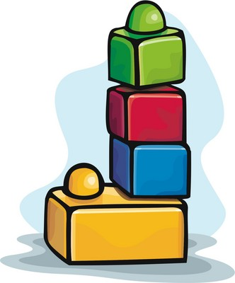
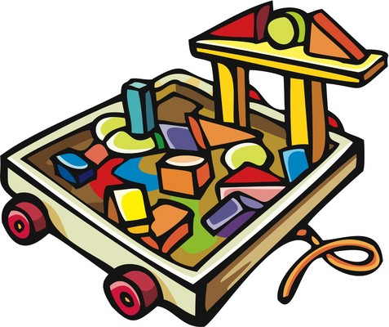
The more we together, together, together,
build
The more we together, the happier we’ll be.
build
Cause your are my .
blocks
blocks
And my are your .
blocks
blocks
The more we together, the happier we’ll be!
build

Slide 5
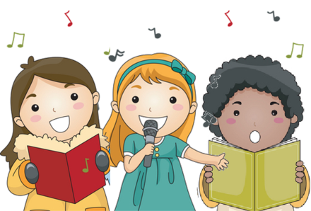
The more we together, together, together,
sing
The more we together, the happier we’ll be.
sing
Cause your is my .
song
song
And my is your .
song
song
The more we together, the happier we’ll be!
sing

Slide 6
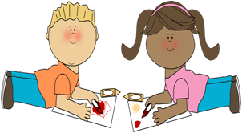
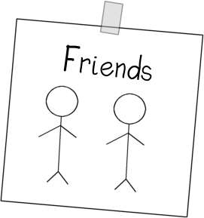
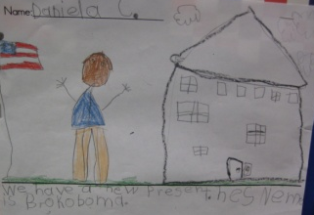
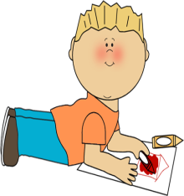
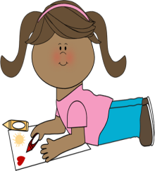
The more we together, together, together,
draw
The more we together, the happier we’ll be.
draw
Cause your is my .
art
art
And my is your .
art
art
The more we together, the happier we’ll be!
draw

Slide 7
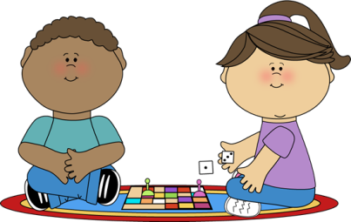
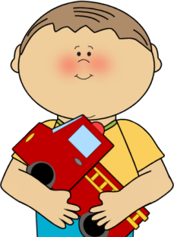
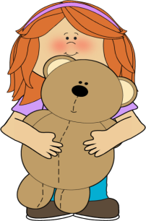
The more we together, together, together,
play
The more we together, the happier we’ll be.
play
Cause your is my .
toy
toy
And my is your .
toy
toy
The more we together, the happier we’ll be!
play

Slide 8
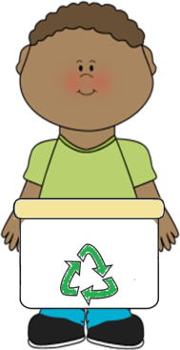
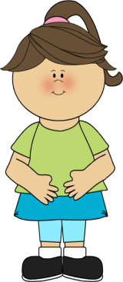
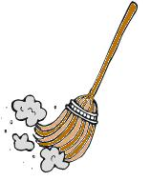
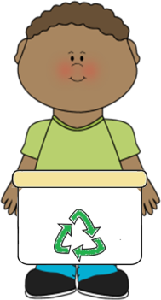
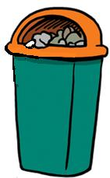
The more we together, together, together,
clean
The more we together, the happier we’ll be.
clean
Cause your is my .
mess
mess
And my is your .
mess
mess
The more we together, the happier we’ll be!
clean

Slide 9
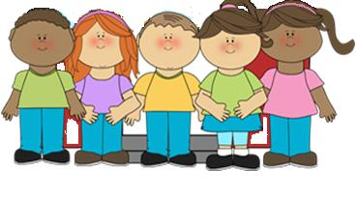
The more together, the happier we’ll be.
we are
The more together, the happier we’ll be!
we are

